Slide 1


Track: Cactus AI Labs Title: Academic Research Remix
Sponsors: Cactus AI Labs, Glitch over, Intech, Crest Data Systems, Ai city labs, JK Lakshmi Cements
Institute: Institute of Technology, Nirma University
Team: Data Pirates
Team Members:
Harvy Doshi(Team Leader) – 22BCE084
Drashti Vaghasiya – 22BCE086
Yatra Bhimani – 22BCE039
Heli Detroja – 23BCE504
Ankeshree Solanki – 22BCE341

Slide 2

Problem statement
A team should basically choose and work on only 1 type of generation only for the hackathon,
whichever you are comfortable with w.r.t tech stack (Computer Vision, Speech or NLP)

Slide 3
Introduction
In today’s fast-paced world, effectively presenting research insights is crucial. However, manually creating tailored presentations from extensive research papers is often time-consuming and resource-intensive. Our solution addresses this challenge by developing a tool that generates dynamic and customized presentations directly from research paper PDFs.
The tool is designed to cater to two distinct presentation formats:
Formal Presentations: Suitable for professional and academic settings such as conferences and seminars, focusing on structured, data-driven insights with a polished layout.
Informal Presentations: Creative, engaging, and fun explainer presentations targeted at a wider audience, breaking down complex research into digestible and visually appealing content.

Slide 4
Advantages of our Solution
Time-Efficient and Automated: Say goodbye to the tedious manual process of creating presentations. Our solution quickly extracts, summarizes, and visualizes key insights from
research papers.
2. Versatile Content Generation: Supports both formal and informal presentation types:
Conference-ready, structured PPTs for professional settings.
Fun, explainer-style presentations for a broader audience.
3. Domain-Agnostic Capability: Designed to handle research papers from any subject domain, ensuring maximum flexibility for users.
4. Dynamic Graphical Abstracts: Generate flowcharts or mind maps to visually represent research findings, enhancing audience engagement and comprehension.
5. Customization at Every Step:
Tailor slide structure, content focus, and design elements.
Selectively include or exclude components in graphical abstracts.
6. Cutting-Edge Tech Stack: Powered by advanced models (Mixtral-8x7b, Groq) and robust libraries (pptx, pymupdf, mermaid) for reliable and scalable content generation.
7. User-Centric Design: Built with intuitive user controls, enabling researchers, academicians, and content creators to craft impactful presentations effortlessly.
Our solution empowers users to communicate research insights more effectively, saving valuable time while enhancing visual impact.

Slide 5
Proposed Approach
Chosen Output Format(s):
Primary: PPT and Graphical Abstract
Paper Details:
Number of Papers Supported: Single
Domain/Subject Area: Any domain
Key Approach:
Text Extraction: Extract the content from research paper PDFs using powerful text processing tools.
Summarization: Employ LLM models (Mixtral-8x7b, Groq) to summarize key sections such as objectives, methodologies, results, and conclusions.
PPT Creation: Generate customized slides dynamically using pptx based on the summarized response.
Graphical Abstract Generation: Create visually appealing flowcharts or mind maps using Mermaid based on the content.
Tech Stack & Tools:
LLMs/Models Used: Mixtral-8x7b, Groq
Libraries:pptx: For automated PPT generation
pymupdf, fitz: For efficient PDF content extraction
mermaid: For flowcharts and mind maps

Slide 6
Limitations/Future scope
Token Limit Constraints:
For analyzing lengthy research papers and generating complete summaries or graphical abstracts, token limits in free/open-source models can be exceeded, restricting full content extraction and summarization.
Template Customization Limitations:
The current version does not support advanced template customization for PPT designs beyond basic layouts.
Optimization Potential for Graphical Abstracts:
Given more time, improved and efficient prompts can be developed to enhance the generation of graphical abstracts, as the core pipeline is functional but can be further refined.
These limitations highlight potential areas for future improvement while maintaining a functional and practical solution for research content visualization.

Slide 7
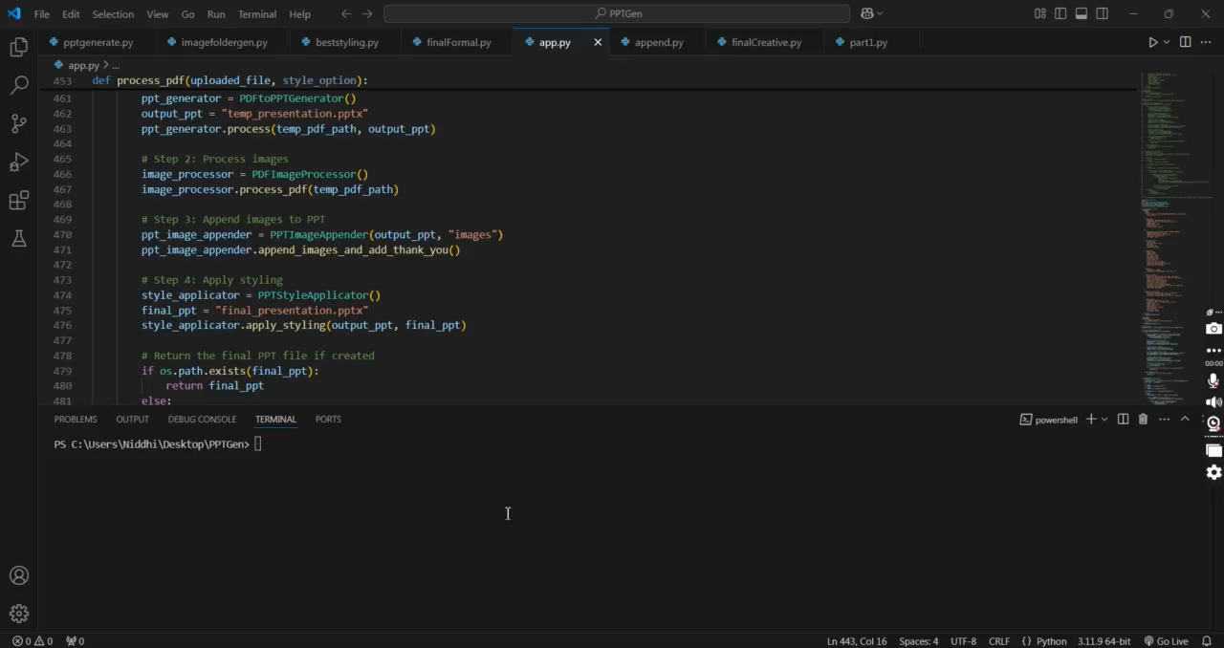
Video-Demo

Slide 8
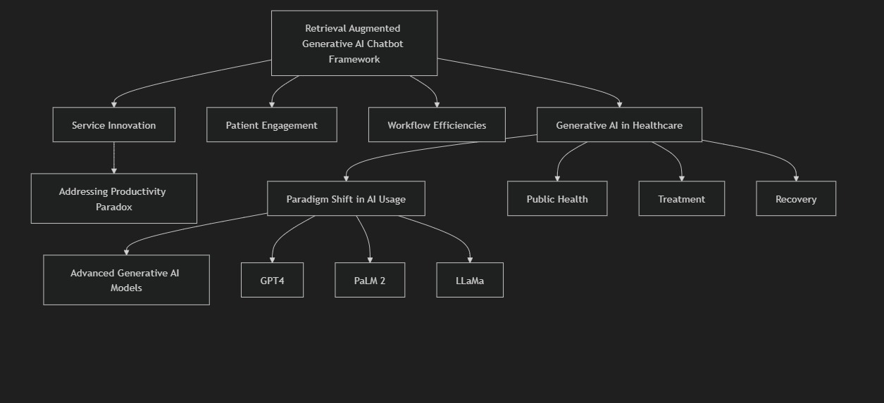
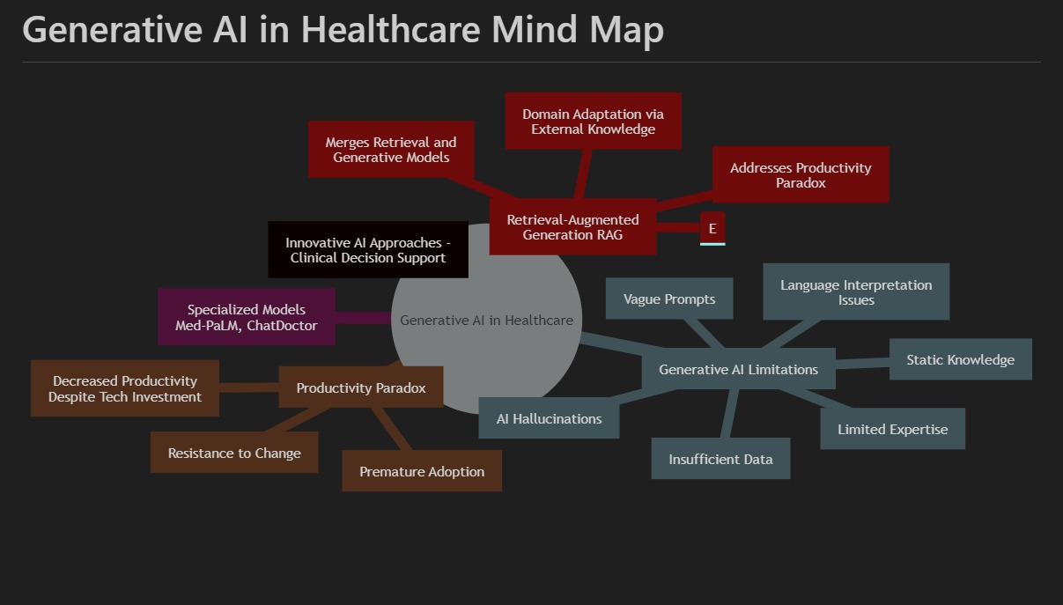
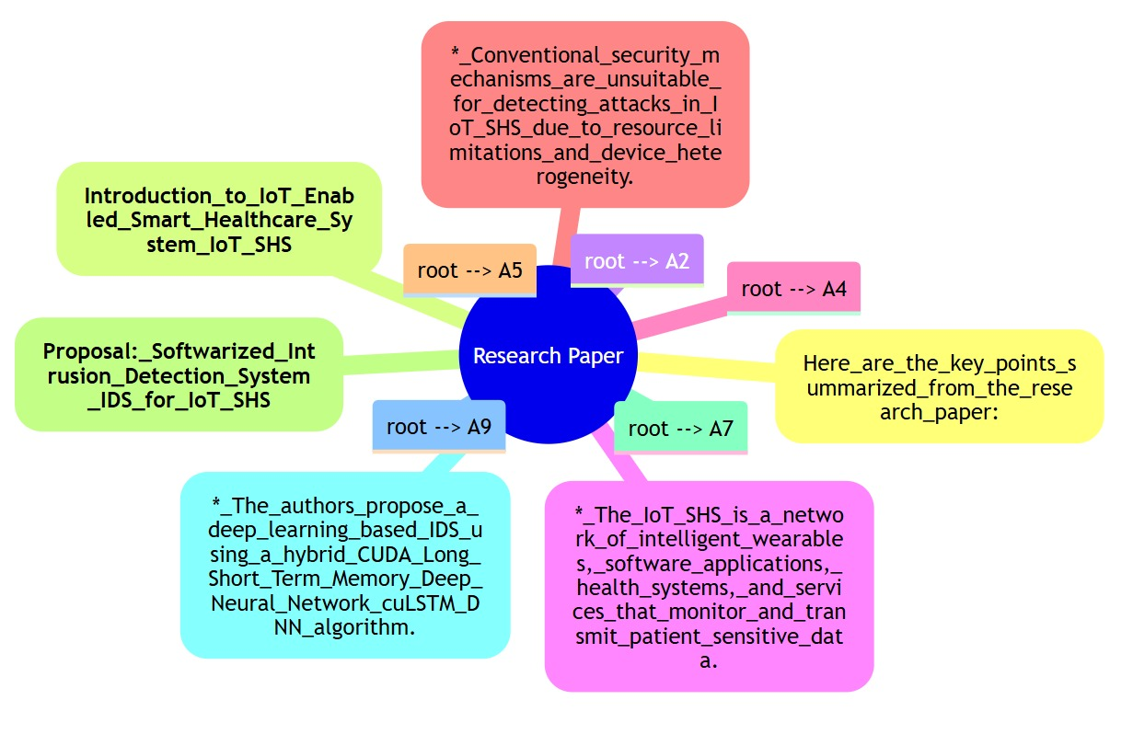
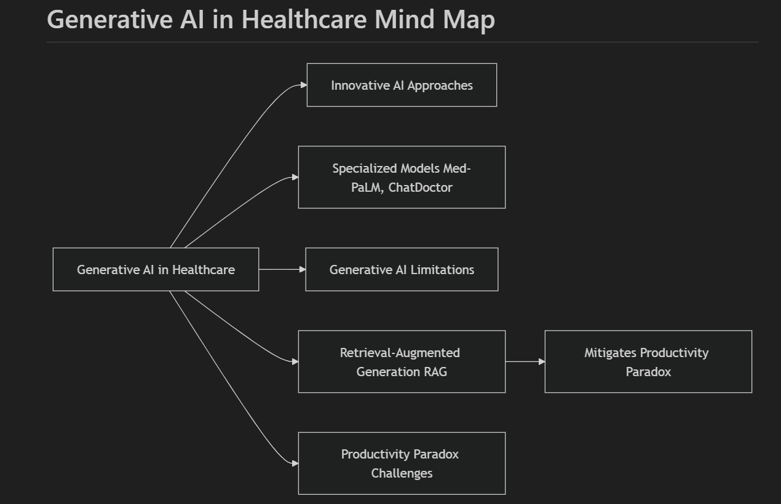
Additional Details & References
https://console.groq.com/docs/openai
https://mermaid.live/
https://github.com/mermaid-js/mermaid

